Slide 1
Drug Resistance Index
Dr. ankur gupta
Sr. medical advisor
Msd india

Slide 2
Why we need DRI ?
Communicating the antimicrobial resistance to policymakers and non-experts is a challenge
It is complicated by the multiplicity of bacterial pathogens and distinct classes of antibiotics used to treat them.
It is difficult, even for experts to infer the seriousness of resistance whether alternative antibiotics are available.
Difficulty in aggregating resistance to multiple drugs to assess trends poses a further challenge to quantifying and communicating changes in resistance over time and across locations.

Slide 3
What is Drug Resistance Index (DRI)
DRI is a method for aggregating bacterial resistance to multiple antibiotics, creating an index comparable to the composite economic indices that measure consumer prices and stock market values.
The resulting drug resistance index (DRI) and various sub-indices show antibiotic resistance and consumption trends

Slide 4
Raw materials to calculate DRI
DRI can be measured at facility level of ward level to measaure the performance of stewardship efforts
Two ingredients to calculate DRI are
Consumption of antibiotic data from pharmacy
Antibiogram from the microbiologists
DRI is measured in 3 simple steps
Preparing resistance data (antibiogram)
Preparing utilisation data (antibiotic consumption)
Collating information and calculating DRI

Slide 5
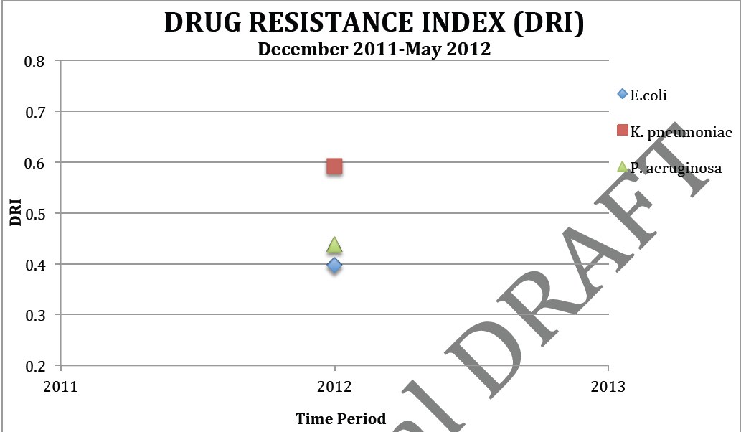
Plotting of DRI curve
Values show overall resistance, adjusted for the prescribed volume in each period.

Slide 6
Interpretation of DRI value
The DRI produces a number between 0 and 1
It is a relative value expressing the overall susceptibility of that species to the basket of antibiotics available to treat it.
It should not be understood as multidrug resistance, but rather the proportion of resistant isolates adjusted for the relative importance (i.e. prescribed volume) of each drug in each period.
The strength of any index is that it makes comparisons over both time and location substantially easier.
For example, an increase in the DRI of Pseudomonas from 0.56 to 0.6 in the next month tells you that that infection has become more difficult to treat, taking into account any changes in prescribing patterns towards more effective antibiotics.
Furthermore, a Pseudomonas DRI of 0.56 in one facility vs. a value of 0.47 in another allows for relative comparisons of resistance between locations.

Slide 7
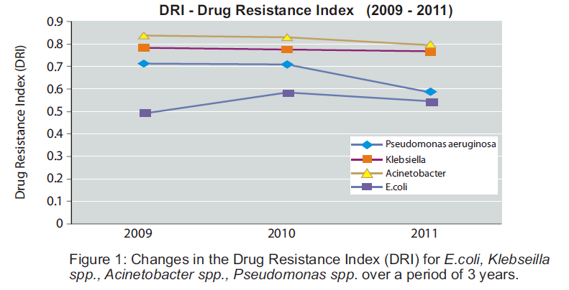
Tracking DRI over a period of time

Slide 8
DRI – Tool for AMS and Infection control in Hopsital
DRI can become an extended arm of Antimicrobial Stewardship (AMS)
DRI has the potential to become an effective outcome measure to assess the impact of AMS implementation on change in antimicrobial resistance
DRI can change the outlook of hospital owners and healthcare professionals towards antibiotic resistance.
DRI can potentially become a marketing tool for hospitals to advertise their infection control and effort on curbing antimicrobial resistance as compared to competitors

Slide 9
DRI – An Update from India
Have completed the pilot DRI calculation for 3 Fortis Hospitals
MSD India has signed a 3 year exclusive partnership with CDDEP for extension and dissemination of DRI in hospitals across India
Have entered into an agreement with Apollo group of hospitals for Pan – Apollo rollout of DRI as an initial step towards AMS implementation

Slide 10
The expected support on DRI
To adopt and own AMS and DRI as signature campaigns by Merck / MSD across AP region / emerging markets for countering antimicrobial resistance
To create think tank of KOLs across these regions with strong endorsement for DRI as a tool to measure and track antimicrobial resistance
To influence the health authorities of repute in the world to validate and include DRI as a surrogate tool to measure and track antimicrobial resistance

Slide 11
Back up slides
How to measure DRI

Slide 12
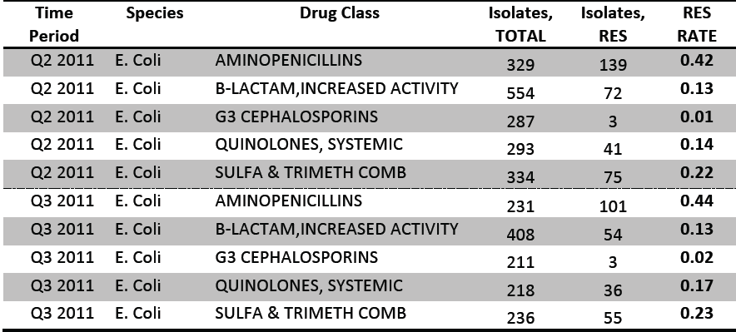
Step 1: Preparing resistance data (antibiogram)

Slide 13
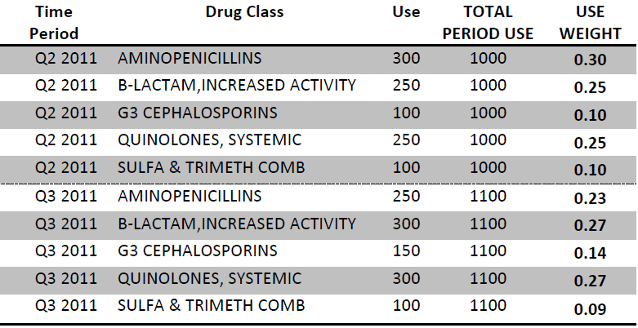
Step 2: Preparing Utilization data (consumption)
Use (Consumption) = DDD / BD × 100
DDD (Defined Daily Dose) = Total Antibiotic consumption (gm) / Total Adult Daily Dose (gm)
BD (Bed Days) = 365 (for 1 yr) × Total beds in hospital × Occupancy Index

Slide 14
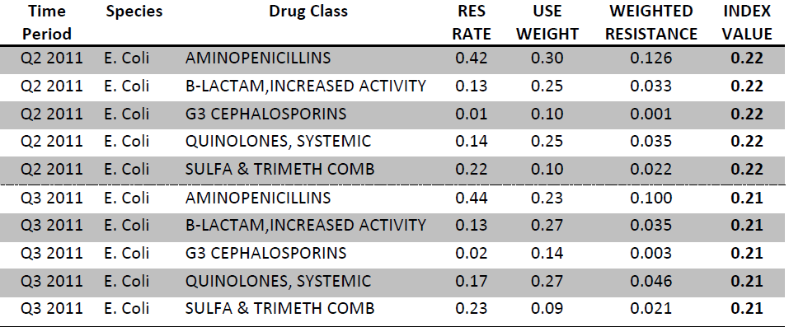
Step 3: Calculating DRI
Use weight = Proportion of a drug used over combined usage of all drugs
Weighted resistance = Resistance rate × Use weight
Index Value = Sum of Weighted resistace

Slide 15
